Slide 1
Customer Experience Report
Author: Ha Nguyen Minh Lam
Email: lamhanguyenminh@gmail.com

Slide 2
Summary
Customer demographic
Customer behavior
The participants are mostly male and the majority of them is under 60
80% of participants satisfied with services
Only 3% of customers are not satisfied
Customer Satisfaction
77% of the transactions are “Fee collection and contract refund” and “Personal details adjustment” and most of them done by group age of 40-49
Insights
The most reason that customers don’t feel satisfied is related to Customer Service
The Agents ’s performance at Office is consider to be at good quality due to larger amount of good assessments
Most of Participants done the survey get their requests done successfully and feel satisfied. The remain is mostly transactions related to claim assistance and policy request
The most reason that customers don’t feel satisfied is related to Customer Service
HCM and Hanoi are 2 cities mainly account for bad experience feedbacks, this feature tend to be high at the beginning of the year

Slide 3
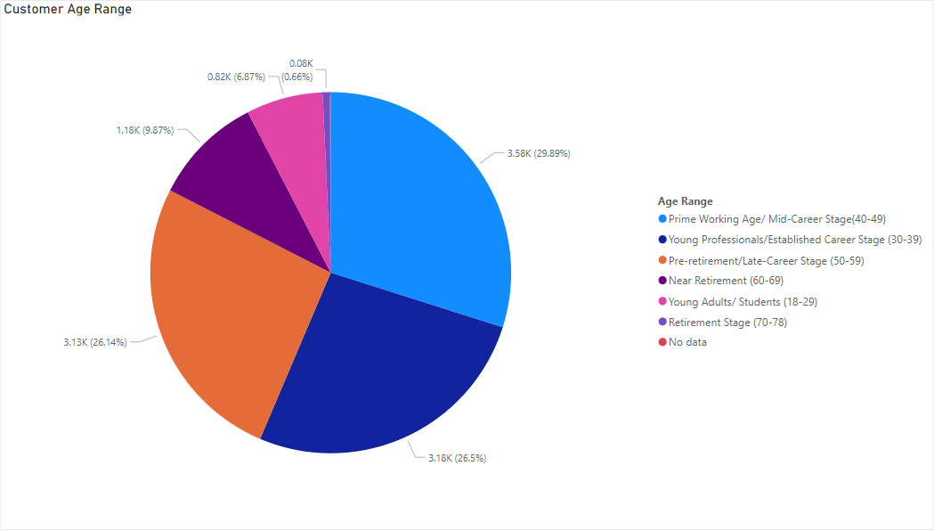
Customer’s demographic
It can be seen that the majority of survey participants are under 60 (89%) while the percentage of who are older 60 only account for about 10%
We can see that there are some of the data (0.6%) not being recorded appropriately that miss the age information about customer, but it just the minority

Slide 4
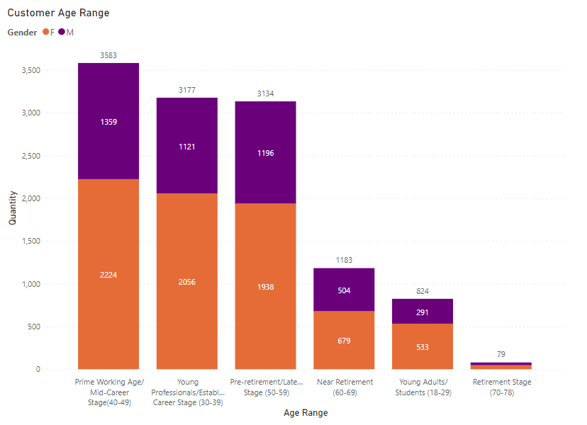
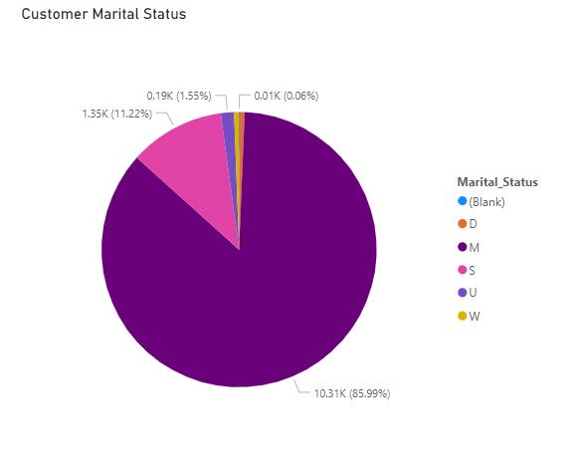
In term of gender, 62% of participant are female. The interesting here is that male and female share a same trend over age ranges that female are approximately 2 times more than man. However this gap of gender is narrowing as the age range (from 60s )go further, the proportion of male and female is nearly the same
The data also reveal some aspects of the participants marital status that the majority of the customers are Single (85.99%) and another significant portion account for 11.22% is Separated

Slide 5
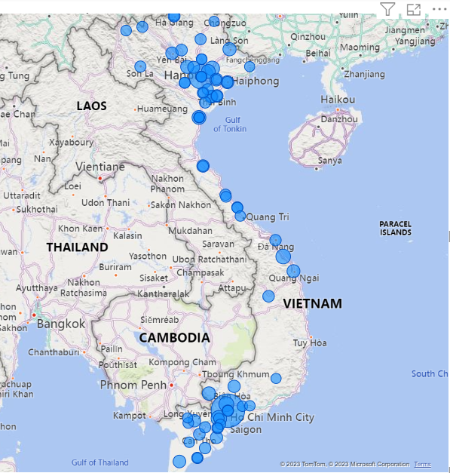
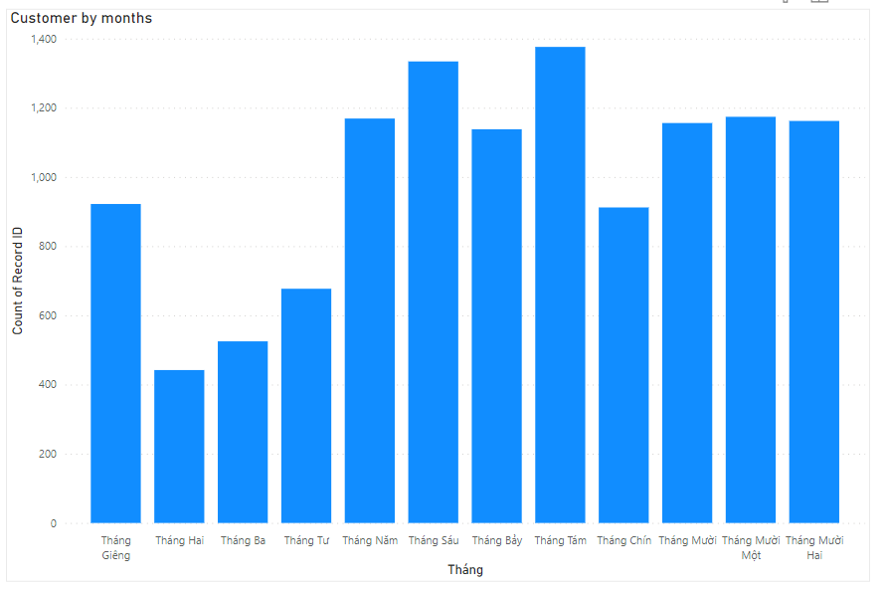
In term of geography, the trend reveals there are lot more transactions at the fourth quarter for the year, while in the first quarter, the number of transactions is relatively modest
A glance at the allocation, the transactions tends to focus on mostly big cities/ provinces at the north ( mainly around Hanoi) and the south ( around HCM City)

Slide 6
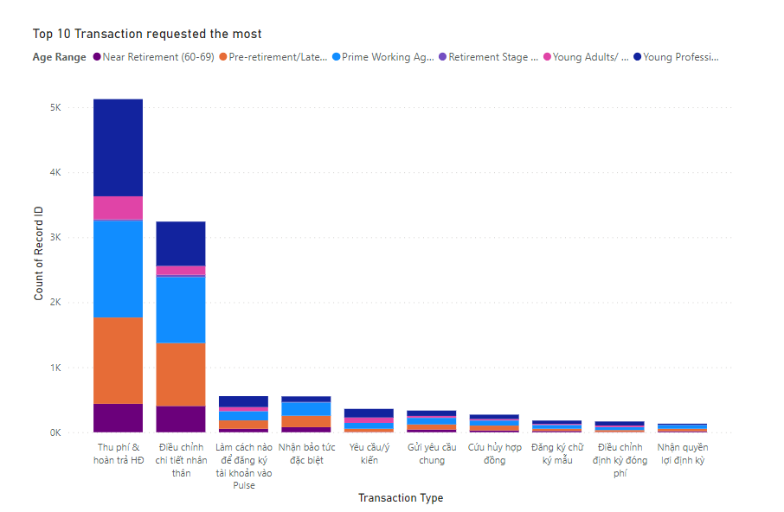
Customer behavior
Most of the transactions done by survey participants are “Fee collection and contract refund” and “Personal details adjustment” ( about 77% of transactions).
Also it reveal that the age range (40-49 ) accounts for the most proportion of transaction, follow by that is (50-59) age range.

Slide 7
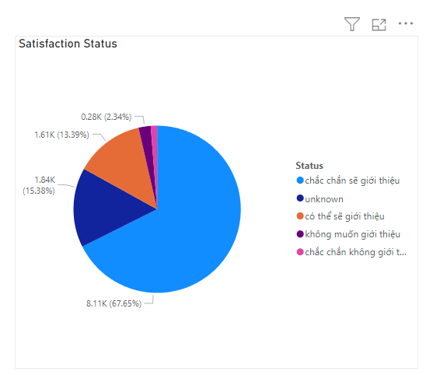
Customer satisfaction
In general, the customer’s satisfaction is at a good rate, which is about 80% account for the percentage of customer’s number that want to introduce / give reference about the insurance services
However, there still remain 3% of customers don’t feel satisfied with the provided services.
15% of the record return no data indicates that this group of customers try to stay neutral when being asked about their satisfaction.

Slide 8
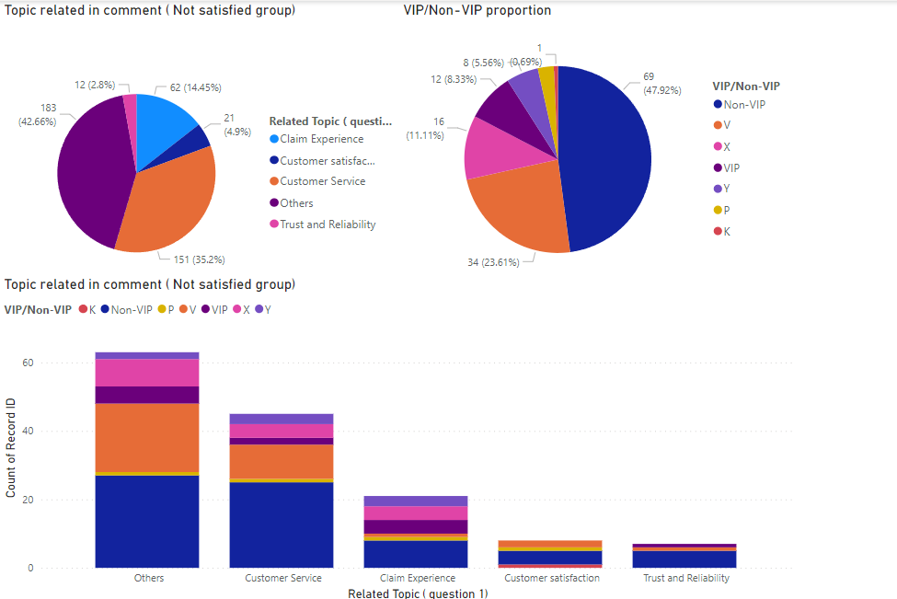
Insights
Question 1-2
Into details, it is clear that the most main reason for customer unsatisfied experience are reasons related to Customer Service ( account for 35% )
It is noteworthy that those customers in V(VIP) group and X ( exclusive ) Group also experience the bad experience related to Customer Service. This can be a warning indicators that Customer Service of the representatives or agents are encountering some problems that need to be looked into

Slide 9
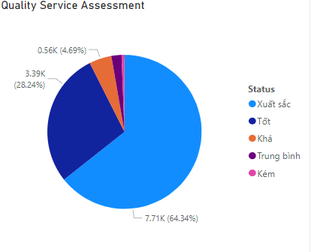
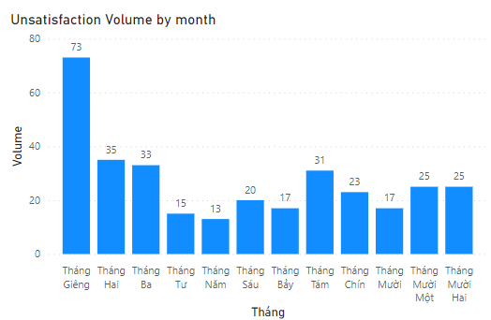
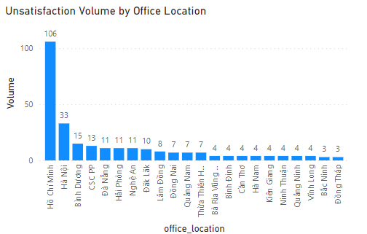
Question 3
When surveyed about quality of the provided services at the Office, participants are almost happy and satisfied with the service ( 98%), yet there are still remain a group of the unsatisfied that we also need to delve into.
It is revealed that the 2 big cities of the north and the south account for the most portion of customer having bad experience. This can be deduced that there is a personnel shortage that is probably the root cause of the problem . Also, this trend tend to be the highest at the beginning of the year and gradually decrease toward the end of the year.

Slide 10
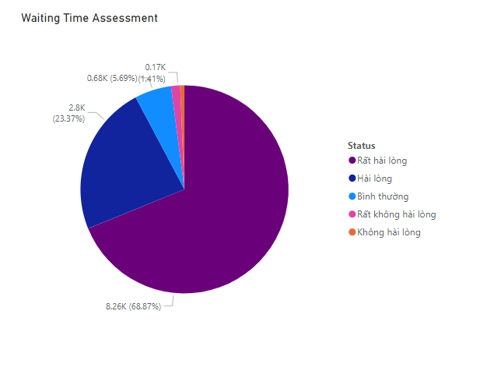
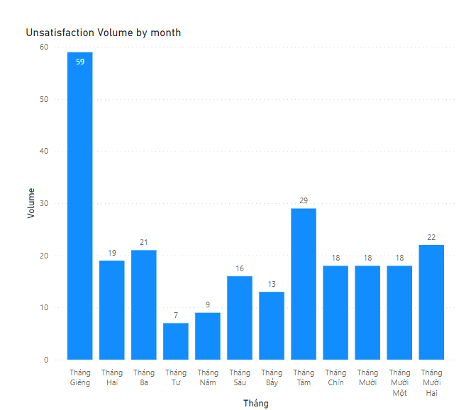
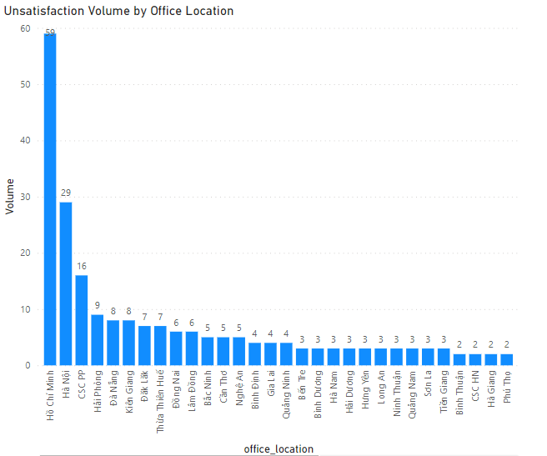
Question 4
The record also return a same pattern to the trending of assessment of customer about time waiting. The participants find it satisfied when giving assessments about this topic ( nearly 98%)
The 2 big cities of the north and the south still account for the most portion of customer having bad experience. This is more certain to claim that due to the huge population, the service provided in these location may be affected. However, other factors also need to be taken into account, such as proficiency of procedures,…

Slide 11
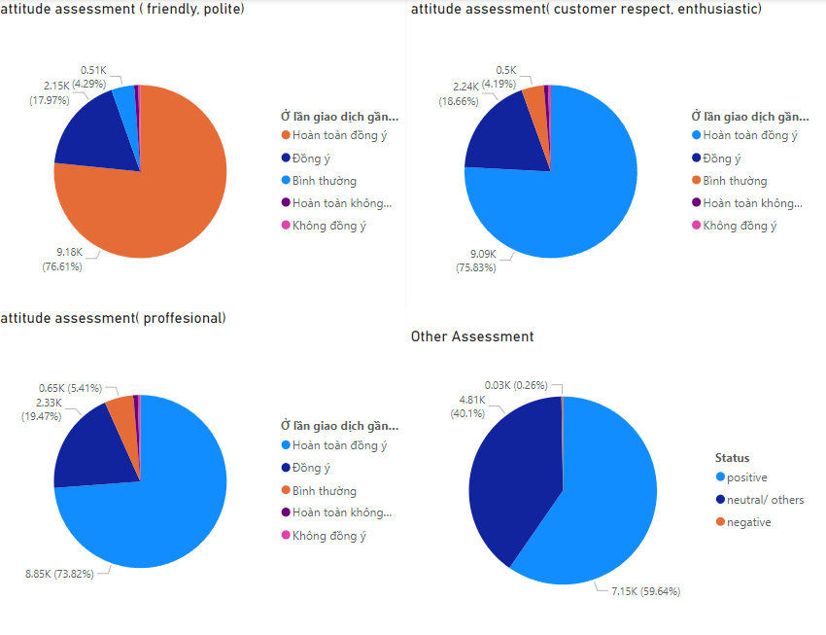
Question 5
In term of Office Agents assessment, participants do show a high appreciate for their friendliness, enthusiastic and professional, also the comments that they leaves at other comments sections show the same positive trend
Nevertheless, it is unavoidable that some participants feel not satisfied toward the service and leave negative feedback. But this is a minority number (0.26%)

Slide 12
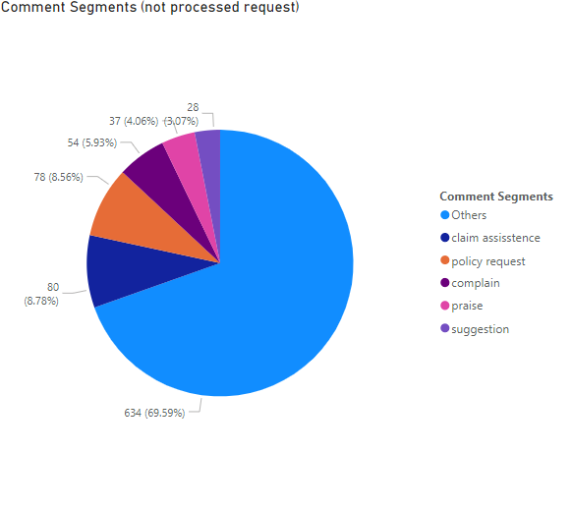
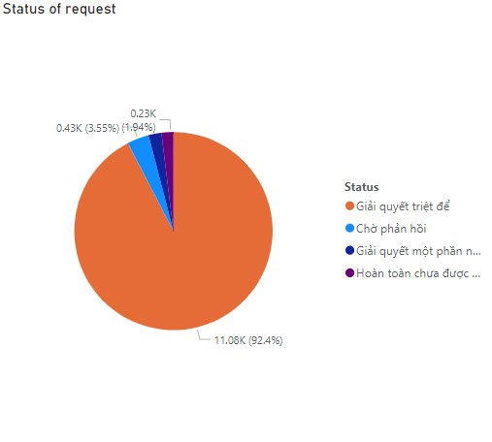
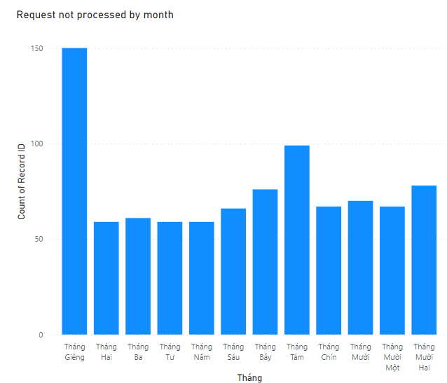
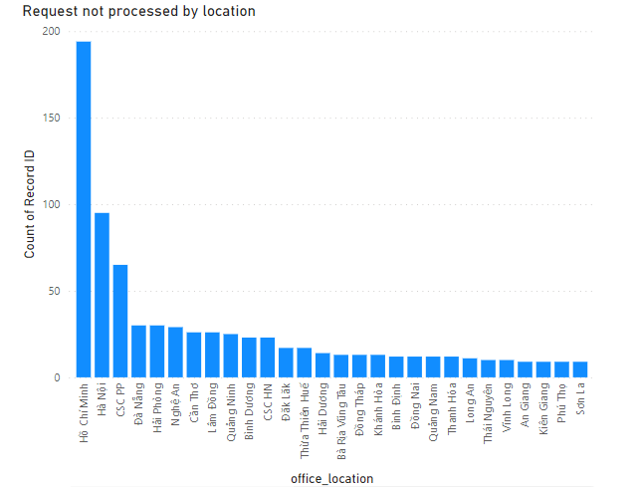
Question 7-9
Delve into the data that reflect what participants need to be taken care about, this is positive that almost every customer is happy with every transaction they have, that reflect through the request that have been successfully proceed.( 92.4%)
However, some of transactions are not likely to proceed their request appropriately that need to be considered. Most of them related to claim assistance 8.78%, policy request 8.56% and complain 5.93%.

Slide 13
Suggestions
Invest in training and development programs for customer service representatives to enhance their skills, responsiveness, and overall customer experience.
Optimize claim assistance and policy request processes to be efficient, transparent, and customer-friendly, enabling smooth interactions and providing a seamless experience.
Pay close attention to feedback trends at the beginning of the year in HCM and Hanoi, identifying recurring issues and proactively addressing them to mitigate customer dissatisfaction.
Regularly analyze customer feedback, identify areas for improvement, and implement necessary changes to enhance the overall customer experience, ensuring a customer-centric approach is maintained.

Slide 14

Thank you
Thank you for taking the time to read this report. I appreciate your attention and consideration.
Email
lamhanguyenminh@gmail.com

